Slide 1

HCI - Assignment n.2
Design and prototyping of an application using a human-centered approach
Final presentation and demo
Project Title: XYZ an application for …
Group: Alice, Bob & Carol
Lab Class: PX
HCI 2020-2021

Slide 2
Introduction
Insert project title here
Brief contextualization / motivation.
Why this project?
Relation to other courses? (e.g. Data Bases, Project…)
Personal Interest? Elaborate
….
HCI 2020-2021
2
Notes:
These first slides are a recap of the first presentation and should be presented without much detail

Slide 3
Project Objectives
Insert project title here
Define high-level goals
What are the expected outcomes?
What are the benefits?
HCI 2020-2021
3

Slide 4
Personas
Select 1 or 2 main target users
Define the corresponding personas:
Include name, gender, age, profession, background, main motivations, goals and needs …
Do not include too much detail
HCI 2020-2021
4

Slide 5
Scenarios
Define context of use through main scenarios
Define short concepts or descriptions of how users (personas) will use the application
Should not to go into too much detail
HCI 2020-2021
5

Slide 6
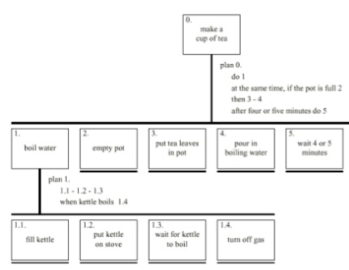
Tasks
For each scenario indicate the main tasks that users will perform using the application
Identify relevant issues of the context of use, if necessary (e.g. mobile usage, noise, dust, stress level, etc.);
Which tasks will become easier using the application (taking advantage of the capacities) then how they are performed currently (without the application)?
Include the decomposition of the main task using Hierarchical task analysis
HCI 2020-2021
6

Slide 7
Requirements
Define a set of requirements (non-functional, functional, …) based on the objectives and personas:
Non-functional requirements – specify the main usability requirements
(ease of learn or ease of use? …) and other that would be the most relevant (privacy, …)
Functional Requirements - specify the main functionality the application should support
HCI 2020-2021
7

Slide 8
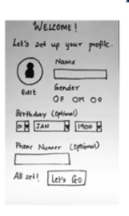
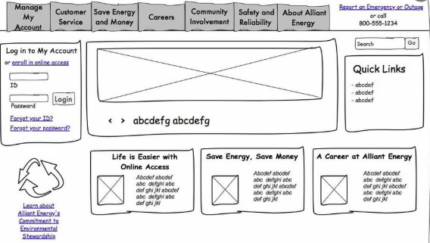
Low Fidelity Prototype (LFP)
Insert app title here
Paper or digital prototype?
Present the main features of your solution according to your pre-defined list of requirements.
Use images and/or videos to contextualize.
HCI 2020-2021
8
Notes:
This is new material; should be presented in more detail

Slide 9
LFP User Evaluation
Insert app title here
Present the method used.
What did you want to evaluate?
Which personas and scenarios were addressed?
What tasks were used?
How many participants and which profiles?
Present the main results
Present new features identified and changes you may have made to the conceptual model.
END OF 1st DEVELOPMENT CYCLE!
HCI 2020-2021
9

Slide 10




Platform Used for the functional prototype
Insert app title here
Present the main tools used.
Specify any libraries used.
Any specific hardware?
Why have you select these technologies?
HCI 2020-2021
10

Slide 11
User Evaluation of the functional prototype
Present the method used.
What was the goal? What did you want to evaluate?
Which persona(s) and scenarios were addressed?
What tasks were used?
How many participants and which profiles?
What questionnaires where used?
Present the main results
Use charts or images to highlight main observations.
Present new features identified and changes you have (should) made after this evaluation.
END OF 2nd DEVELOPMENT CYCLE!
HCI 2020-2021
11

Slide 12
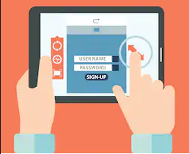
Demo
Insert app title here
Present the main features.
HCI 2020-2021
12

Slide 13
Future work
If you were to continue the project, what would be the next steps?
Effort of each group member
(same effort or anything else?)
HCI 2020-2021
13

Slide 14
Acknowledgments
To all participants ….
(This template is based on a template produced by Bernardo Marques)
Bibliography
Cooper, A., R. Reimann, and D. Cronin, About Face 3 The Essentials of Interaction Design. Wiley Publishing, Inc., 2007
(Other books, papers, …)
HCI 2020-2021
14

